Slide 1
Architectural design 6441 Build 2
Group 22

Slide 2
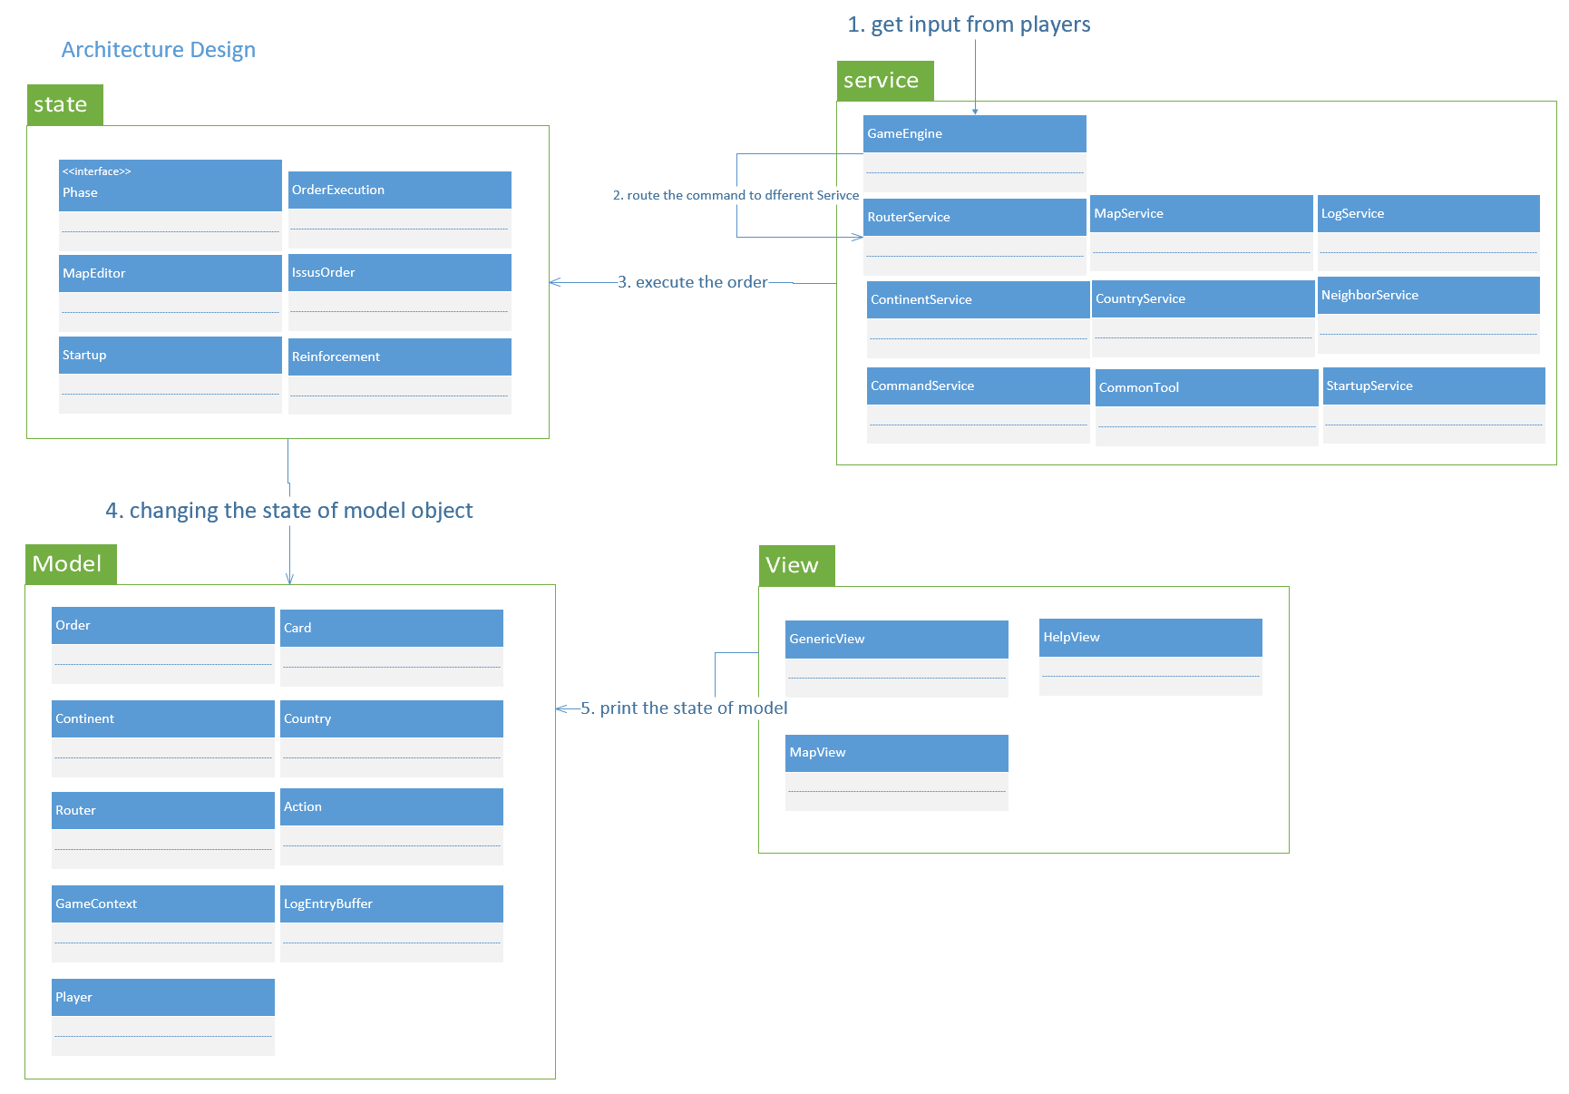

Slide 3
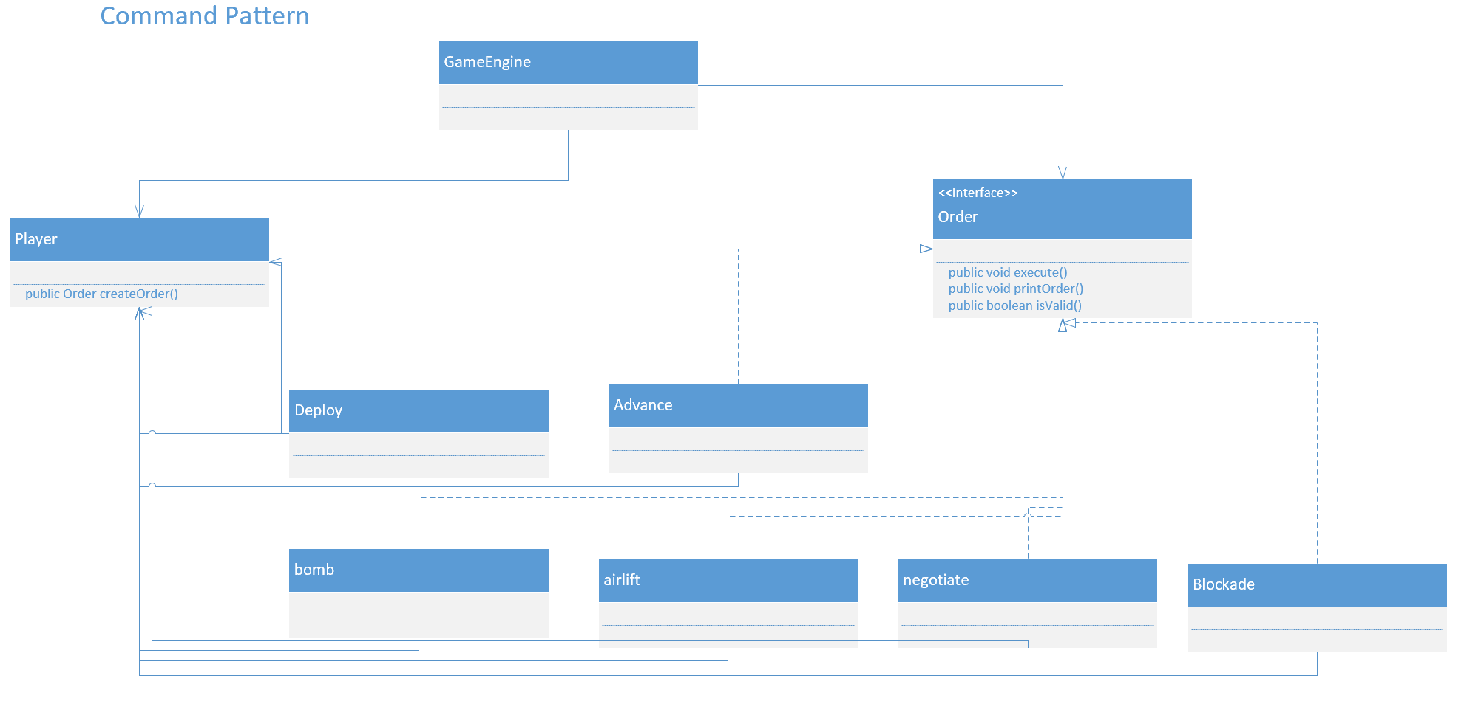

Slide 4
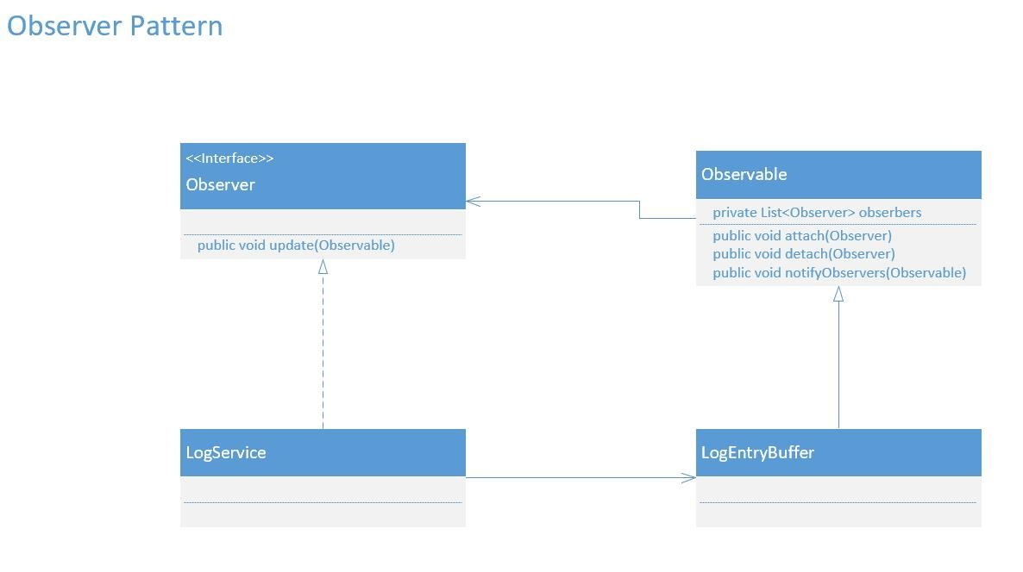

Slide 5
